Slide 1

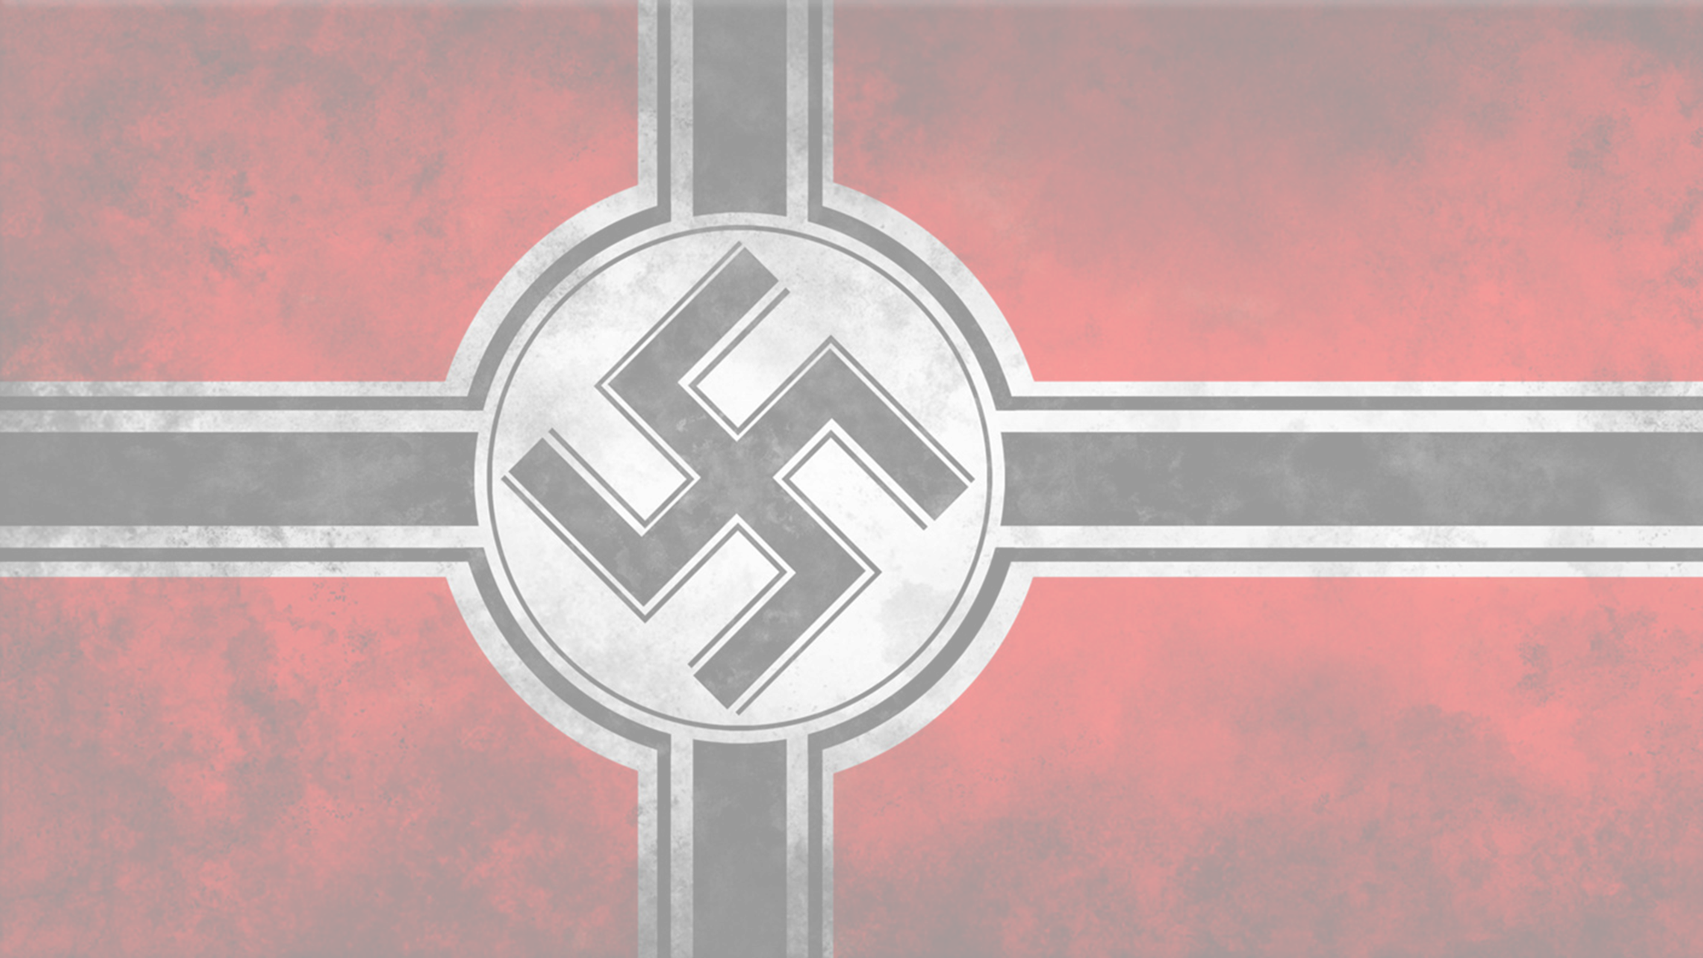


1920-1939
Chapter 24
LIFE IN NAZI GERMANY
life in nazi germany
Strand Three: The History of Europe and the Wider World
@MsDoorley

Slide 2
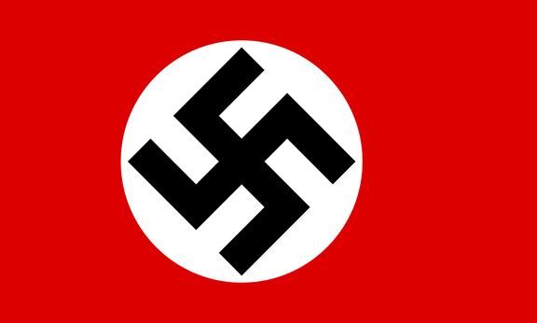
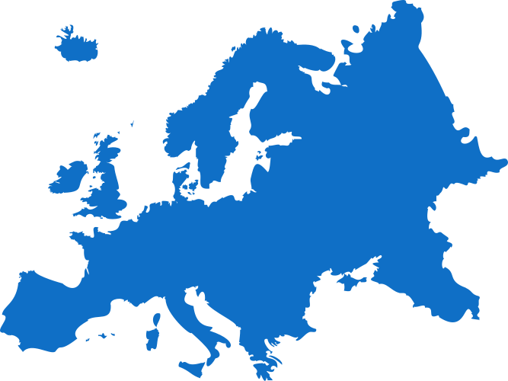
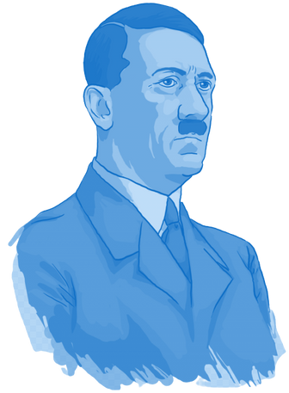
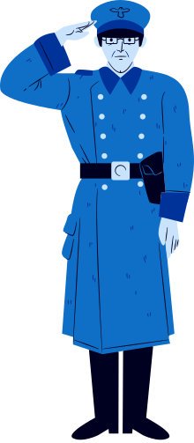


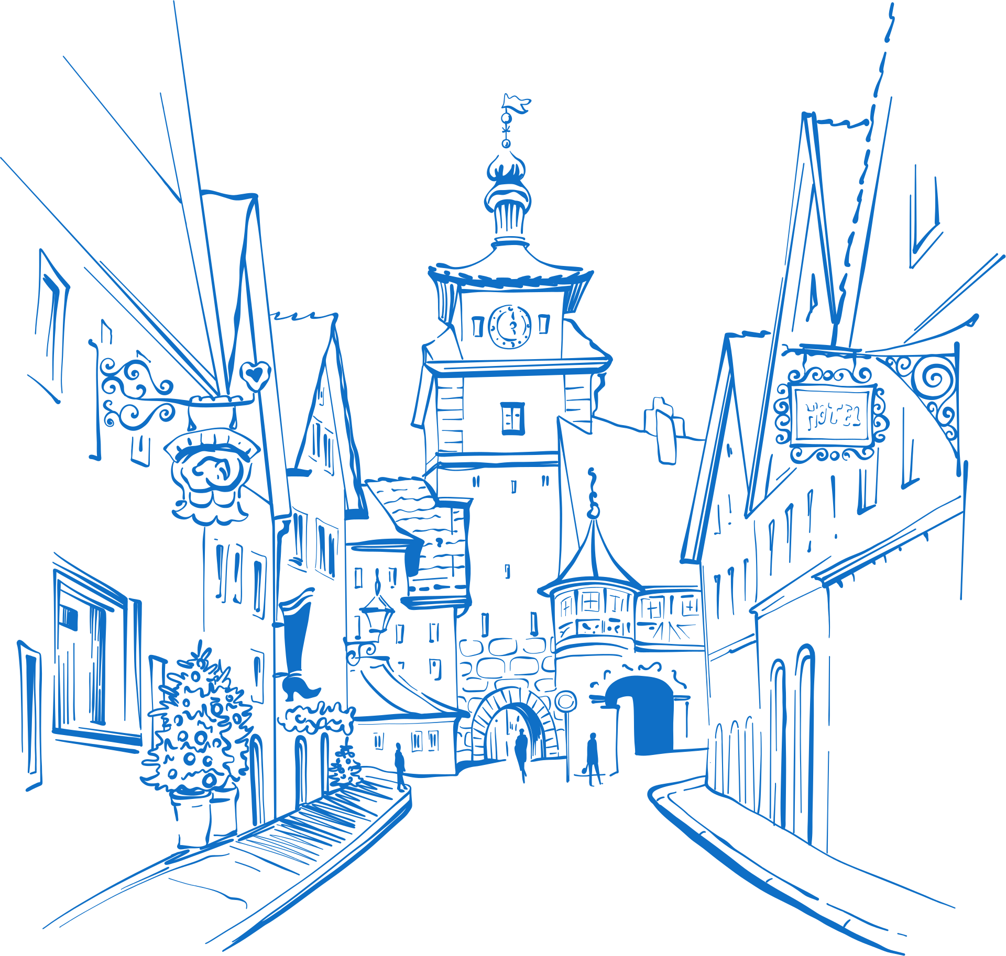
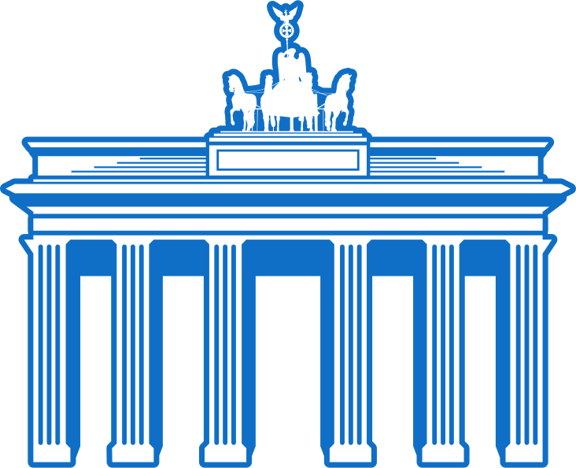
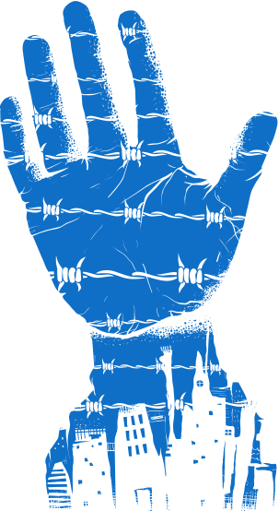
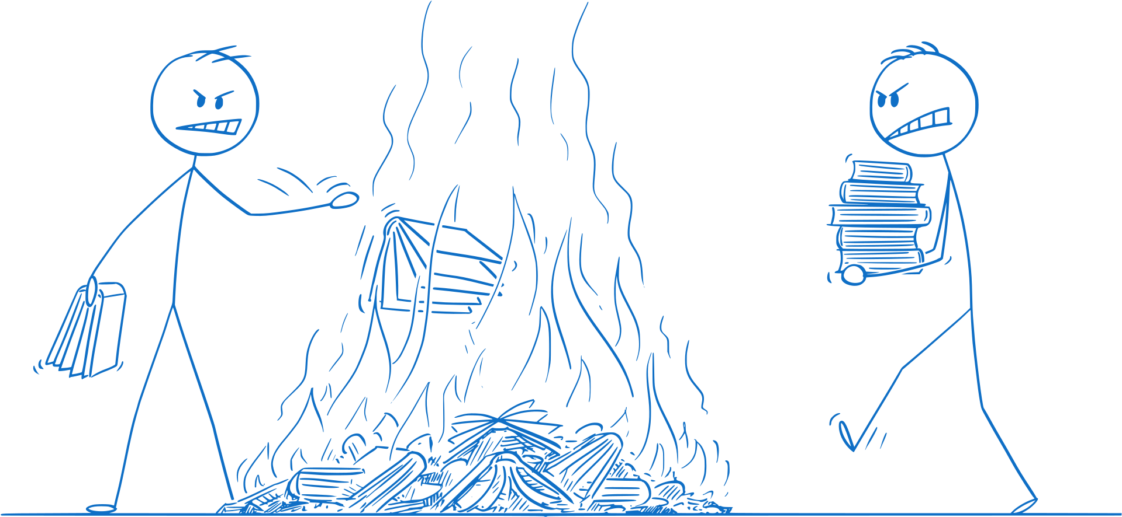
Chapter 24
LIFE IN NAZI GERMANY
3.9 EXAMINE life in one fascist country and one communist country in the twentieth century
Beer Hall Putsch fails in its attempt coup and Hitler is imprisoned: Mein Kampf is written.
The Night of the Long Knives: members of the SA are purged.
Kristallnacht (The Night of the Broken Glass); hundreds of Jewish properties and business are destroyed.
Strand Three: The History of Europe and the Wider World
Chapter Twenty-Four: Life in Nazi Germany
1920
1923
1933
1934
1935
1938
1939
Hitler becomes the Chancellor of Germany.
The Nuremberg Laws are put in place, stripping Jews of numerous rights
World War II breaks out, throwing Europe into its second world war in less than 2 decades.
Adolf Hitler forms the NSDAP
@MsDoorley

Slide 3
Learning Outcomes
3.9 EXAMINE life in one fascist country and one communist country in the twentieth century.
1.7 DEVELOP historical judgements based on evidence about personalities, issues and events in the past, showing awareness of historical significance.
1.9 DEMONSTRATE awareness of the significance of the history of Ireland and of Europe and the wider world across various dimensions, including political, social, economic, religious, cultural and scientific dimensions.
1.10 DEMONSTRATE chronological awareness by creating and maintaining timelines to locate personalities, issues and events in their appropriate historical eras.
Strand Three: The History of Europe and the Wider World
Chapter Twenty-Four: Life in Nazi Germany
@MsDoorley

Slide 4
Introduction
After World War I, Germany became a democracy named 'the Weimar Republic', after the town where it was founded. The Weimar government was in power during the signing of the Treaty of Versailles. Many Germans blamed these politicians for failing to restore Germany's greatness - and even for defeat in World War I, because they signed the armistice ending the war in November 1918. For this, they were nicknamed "the November Criminals”. During the 1920s, Germany suffered much economic problems with high levels of unemployment and inflation as the country tried to recover from the loss and the terms of the Treaty.
Strand Three: The History of Europe and the Wider World
Chapter Twenty-Four: Life in Nazi Germany
@MsDoorley

Slide 5
1920-1939
Chapter 24
24.1: HITLER'S RISE TO POWER
24.1: hitler's rise to power
Strand Three: The History of Europe and the Wider World
@MsDoorley

Slide 6
The Nazi Party
The National Socialist German Worker’s Party (NSDAP), or Nazi Party for short was founded in 1919 and was originally very small. Extremely anti-Communist, the Nazi Party wanted to scrap the Treaty of Versailles. After World War I, Adolf Hitler worked as a spy for the German Army and was sent to investigate the Party in Munich in 1919. He went to a meeting and gave a speech for which he was then asked to become a member. Hitler was a gifted speaker and was soon chosen as party leader.
Hitler and the Nazi Party organised a rebellion in Munich in November 1923, commonly known as the Beer Hall Putsch became it began in a beer hall. It was quickly halted and Hitler, along with other Nazis, was sent to prison. Hitler was released after nine months of his four-year sentence. While in prison, he wrote Mein Kampf ('My Struggle'), which outline the core Nazi beliefs and his vision for the future of Germany. In it, he claimed the Jews and communists in particular were major threats to Germany. This marked the beginning of his persecution of the Jews. He also put emphasis on 'racial purity' and demanded an end to the humiliating Treaty of Versailles and more territory for Germany in Central Europe - which he called Lebensraum ('living space' for ethnic Germans).
Strand Three: The History of Europe and the Wider World
Chapter Twenty-Four: Life in Nazi Germany
@MsDoorley

Slide 7
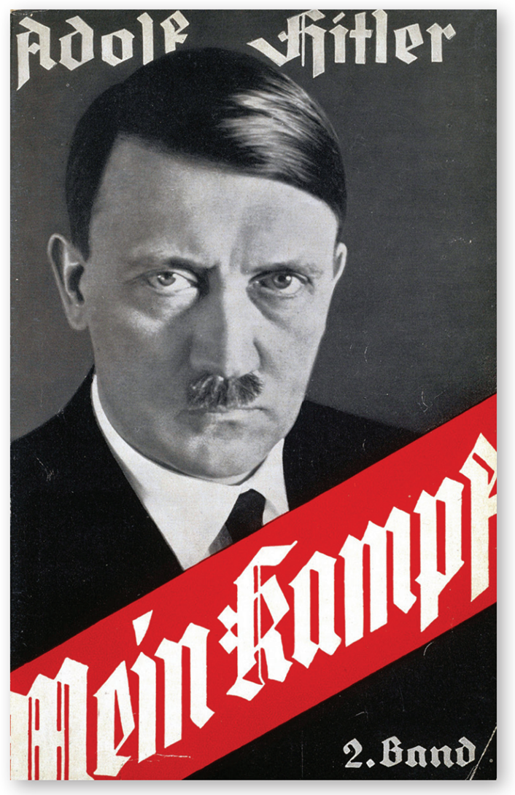
Strand Three: The History of Europe and the Wider World
Chapter Twenty-Four: Life in Nazi Germany
Diagram taken from Artefact, 2nd Edition by Eimear Jenkinson and Gregg O'Neill (educate.ie)
@MsDoorley

Slide 8
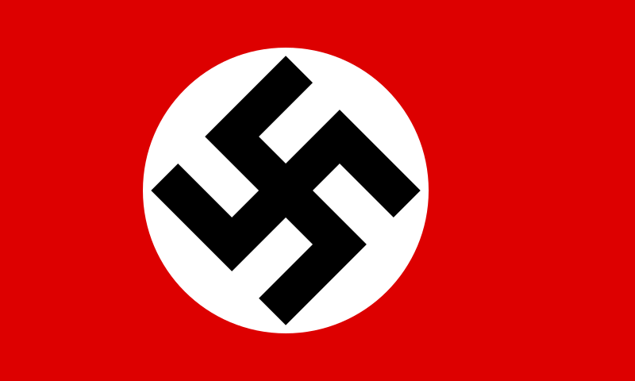
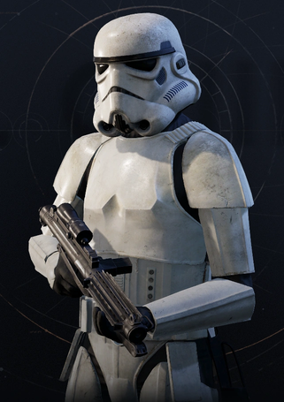
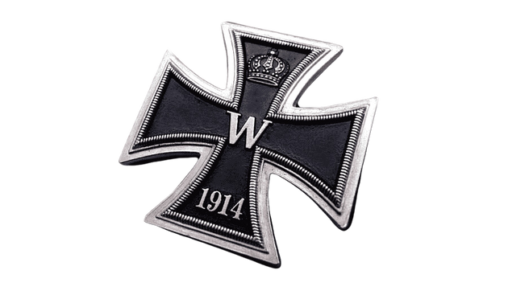
The Nazi Party
Hitler admired Mussolini's Fascist Party and adopted many of it's methods, including the fascist salute, an army - the SA or Sturmabteilung (stormtroopers), also called the Brownshirts - and an emblem. Hitler chose to use the swastika instead of the fasces emblem used by Mussolini and made it the country's official flag.
Strand Three: The History of Europe and the Wider World
Chapter Twenty-Four: Life in Nazi Germany
Did you know?
Did you know?
Hitler was a messenger during World War I and was decorated with the Iron Cross for bravery.
The stormtroopers from Star Wars are named after the Sturmabteilung (SA).
Diagram taken from Artefact, 2nd Edition by Eimear Jenkinson and Gregg O'Neill (educate.ie)
@MsDoorley

Slide 9
The Rise of the Nazi Party
Several factors helped Hitler and the Nazi Party to rise to power:
  The unpopularity of the Weimar government; Many blamed the Weimar government for Germany's defeat, for the harshness of the Treaty of Versailles and the hard times afterwards.
  The Great Depression: The German economy was on its knees after World War I. Germany took out loans from the US during the 1920s to try to recover. However, in 1929 the US experienced the Wall Street Crash, when the value of shares in the New York stock exchange suddenly collapsed, throwing the USA and connected economies into chaos and resulted in a global economic depression. The international Great Depression that followed lasted over a decade. US banks withdrew their loans from Germany. Banks and factories closed and unemployment soared.
  Hitler's leadership and policies: The Beer Hall Putsch, though unsuccessful, showed that Hitler was trying to bring about change. His public speaking skills were of great benefit to the Nazi Party. Hitler opposed the Treaty of Versailles and promised to fix the economy, something people desperately needed. His nationalism appealed to a defeated people because it encouraged them to take pride in their nation and reassured them that he could restore Germany to greatness. He was also anti-Communist, and the wealthy feared communism, so his party had their support.
Strand Three: The History of Europe and the Wider World
Chapter Twenty-Four: Life in Nazi Germany
@MsDoorley

Slide 10
The Rise of the Nazi Party
  Propaganda: Hitler used propaganda to his advantage. He used short simple slogans so everyone could understand. He played on people's emotions, particularly in relation to the Treaty of Versailles, unemployment and communism.
  In creased popularity in elections: The Nazi Party gained more seats in parliament (the Reichstag) with each general election. In 1928, it had 12 seats. By 1932, it had 230 seats. Soon, the Nazi Party had become the largest party in Germany.
On 30th January, Hitler was appointed Chancellor (Prime Minister) of Germany by President Hindenburg. And thus, he began to form his dictatorship.
Strand Three: The History of Europe and the Wider World
Chapter Twenty-Four: Life in Nazi Germany
@MsDoorley

Slide 11
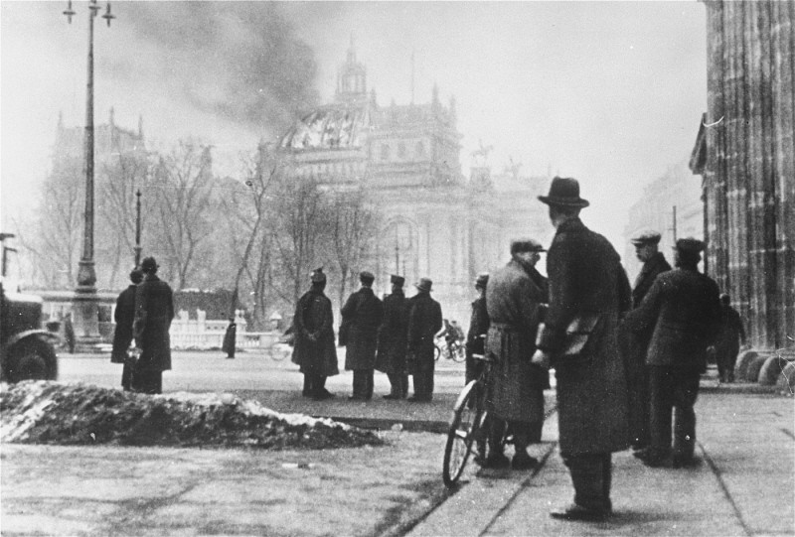
Strand Three: The History of Europe and the Wider World
Chapter Twenty-Four: Life in Nazi Germany
Diagram taken from Artefact, 2nd Edition by Eimear Jenkinson and Gregg O'Neill (educate.ie)
@MsDoorley

Slide 12
Creating a dictatorship
In February 1933, the Reichstag building was set on fire, allegedly by a Dutch communist. This provided Hitler with an excuse to ban the Communist Party and give extra powers to his SA.
Hitler called a general election in March 1933. Hitler's SA, along with his bodyguards known as the Waffen SS (Schutzstaffel), attacked opponents and voters. Votes for the Nazis soared, but they failed to win an overall majority.
Hitler created a law called the Enabling Act in March 1933. This allowed him to rule by decree, meaning he could make laws without going through parliament first - creating a dictatorship. Hitler was now known as der Führer ('the leader').
Strand Three: The History of Europe and the Wider World
Chapter Twenty-Four: Life in Nazi Germany
@MsDoorley

Slide 13
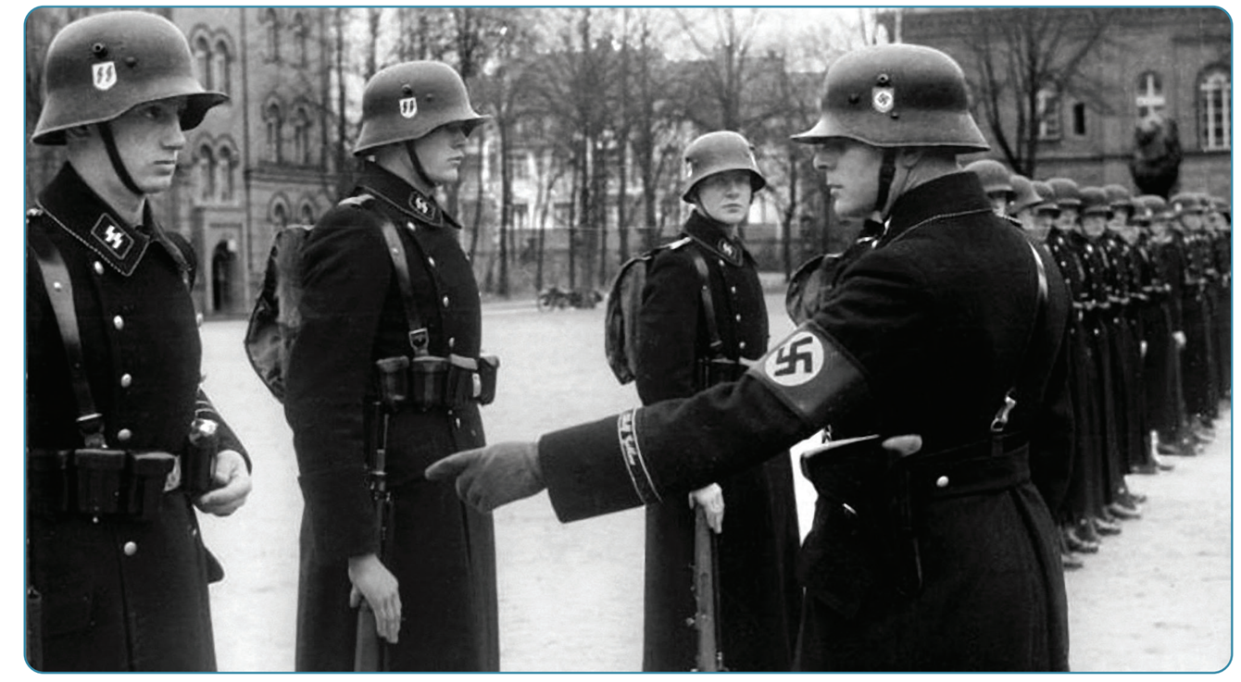
Strand Three: The History of Europe and the Wider World
Chapter Twenty-Four: Life in Nazi Germany
Diagram taken from Artefact, 2nd Edition by Eimear Jenkinson and Gregg O'Neill (educate.ie)
@MsDoorley

Slide 14
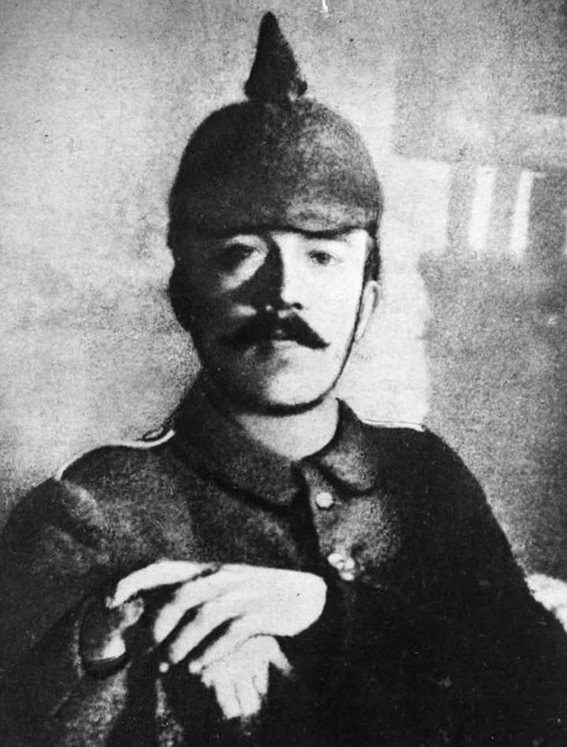
Adolf Hitler, 1889-1945
Adolf Hitler was born in Braunau am Inn, Austria. He was expelled from a couple of schools before moving to Vienna in 1905 to pursue his dream of becoming an artist. In 1914, he moved to Munich, where he hoped to become an architect. He joined the German army when World War I broke out. After the war, Hitler joined the National Socialist German Workers' Party (NSDAP), or Nazi Party. By 1921, he had become its leader. While in prison for the failed revolution known as the Beer Hall Putsch, Hitler wrote Mein Kampf ('My Struggle'). In 1933, Hitler became German Chancellor. When President Hindenburg died in 1934, Hitler abolished the presidency and declared himself der Führer, leader of Germany. Germany's 1939 invasion of Poland on his orders marked the outbreak of World War II. After five years of war, as the Red Army surrounded Berlin, Hitler married his girlfriend Eva Braun. On 30th April 1945, the couple took their own lives before they could be arrested by the Red Army.
Strand Three: The History of Europe and the Wider World
Chapter Twenty-Four: Life in Nazi Germany
Diagram taken from Artefact, 2nd Edition by Eimear Jenkinson and Gregg O'Neill (educate.ie)
@MsDoorley

Slide 15
Checkpoint pg. 309 (Artefact, 2nd Edition)
  What was the Weimar Republic? What problems did it face?
  What was the Beer Hall Putsch? What was it important in Hitler’s rise to power?
  What beliefs did Hitler write about in Mein Kampf?
  How was Hitler influenced by Mussolini?
  What was the Wall Street Crash? Why was it important in Hitler’s rise to power?
  How did Hitler use propaganda?
  How did Hitler establish a dictatorship after 1932?
Strand Three: The History of Europe and the Wider World
Chapter Twenty-Four: Life in Nazi Germany
@MsDoorley

Slide 16
Checkpoint pg. 309 (Artefact, 2nd Edition)
  The Weimar Republic was the German democratic regime after World War I. Problems it faced were: its politicians were blamed for failing to restore Germany’s greatness, and for the defeat of Germany; Germany was in an economic crisis, with high levels of unemployment and inflation.
  The Beer Hall Putsch is the name given to the Nazi Party’s rebellion in Munich in November1923, which began in a beer hall. It was important in Hitler’s rise to power because Hitler was sent to prison for it, and while in prison he wrote Mein Kampf, laying out all of his Nazi beliefs and his vision for the future of Germany.
  In Mein Kampf Hitler wrote about: communists and Jews as very real threats to Germany; his ideas about racial purity; demanding an end to the Treaty of Versailles; his desire to gain more territory for Germany (Lebensraum).
  Hitler admired Mussolini’s Fascist Party and adopted many of its methods, such as the salute, army and use of an emblem.
  The Wall Street Crash: when the value of shares in the New York Stock Exchange suddenly collapsed, throwing the USA and connected economies into chaos. It was important in Hitler’s rise to power because Germany suffered a Great Depression, which made the Weimar government even more unpopular, and paved the way for the people to demand a change of leadership.
  Hitler used propaganda to his advantage. He did this by using short simple slogans that everyone could understand. He played on people’s emotions to convince them to think in certain ways.
Strand Three: The History of Europe and the Wider World
Chapter Twenty-Four: Life in Nazi Germany
@MsDoorley

Slide 17
Checkpoint pg. 309 (Artefact, 2nd Edition)
7. Hitler established a dictatorship by creating a law called the Enabling Act in March 1933 that allowed him to rule by decree. The previous month the Reichstag had been set on fire; Hitler blamed the communists, banned the Communist Party and gave the SA more power. He created bodyguards known as the SS to attack opponents and voters to make sure the Nazi party gained votes in the general election.
Strand Three: The History of Europe and the Wider World
Chapter Twenty-Four: Life in Nazi Germany
@MsDoorley

Slide 18
1920-1939
Chapter 24
24.3: LIFE IN HITLER’S GERMANY
24.3: life in hitler’s germany
Strand Three: The History of Europe and the Wider World
@MsDoorley

Slide 19
Economic Policies
Hitler had promised to eliminate unemployment. In 1933, six million people were unemployed; roughly 11% of the population. Between 1933 and 1939, Germany’s economy was dramatically transformed.
  Independent trade unions were abolished and strikes were made illegal.
  Public work schemes were created to build the motorway (called Autobahnen) and the Olympic Stadium. Many unemployed people found work on projects such as these.
  Rearmament, in violation of the Treaty of Versailles, began to take place. This involved ships, submarines, planes, arms and ammunition being manufactured again for the German military
  The motor industry also expanded. A new car called Volkswagen (the people’s car) was manufactured in 1937. It was priced at the same cost as a small motorcycle so most people could buy one.
  Hitler cut taxes to encourage private industry. Many companies benefitted from this such as Mercedes-Benz (motors), Siemens (electronics) and Krupps (steel).
Strand Three: The History of Europe and the Wider World
Chapter Twenty-Four: Life in Nazi Germany
@MsDoorley

Slide 20
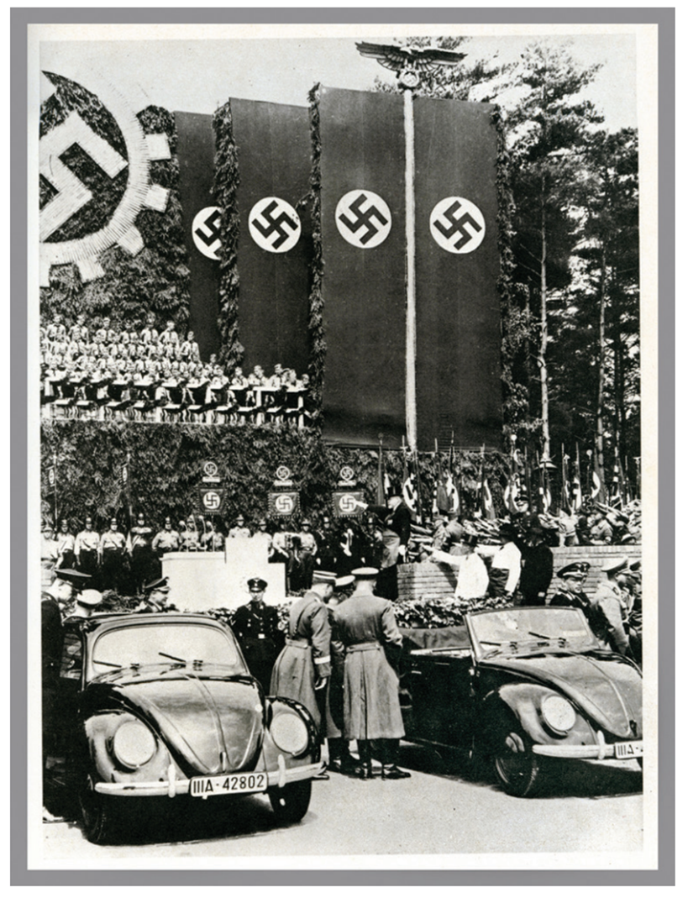
Strand Three: The History of Europe and the Wider World
Chapter Twenty-Four: Life in Nazi Germany
Diagram taken from Artefact, 2nd Edition by Eimear Jenkinson and Gregg O'Neill (educate.ie)
@MsDoorley

Slide 21
Education
  Hitler concentrated on the youth, aware that they would be the future of the Nazi Party. Nazi Youth Groups were set up; Hitler Youth (boys) and League of German Maidens (girls) indoctrinated (brainwashed) the children with Nazi ideology.
  In schools, textbooks were re-written to glorify Hitler, the Nazi Party and Germany. Mein Kampf became the official history book.
  Teachers had to be members of the Nazi Party
  Loyalty to the Führer was taught at every level of education – there was even a portrait of Hitler displayed in every classroom.
Strand Three: The History of Europe and the Wider World
Chapter Twenty-Four: Life in Nazi Germany
@MsDoorley

Slide 22
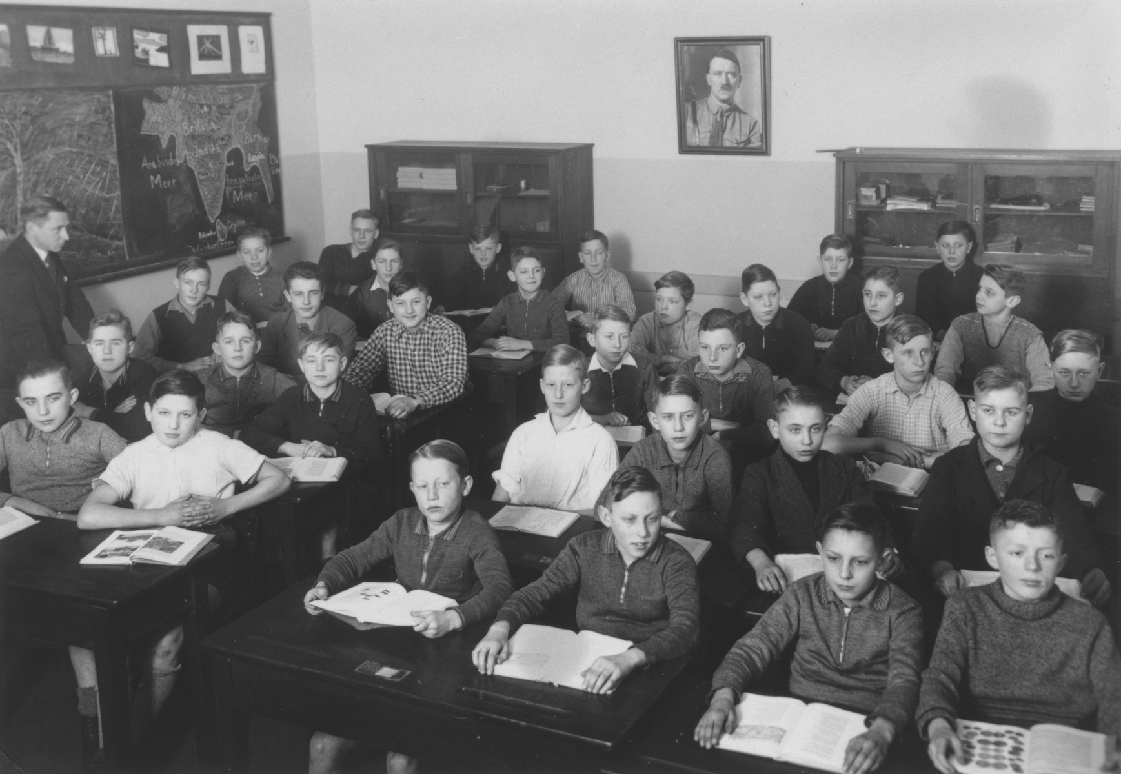
Strand Three: The History of Europe and the Wider World
Chapter Twenty-Four: Life in Nazi Germany
Diagram taken from Artefact, 2nd Edition by Eimear Jenkinson and Gregg O'Neill (educate.ie)
@MsDoorley

Slide 23
Women's Lives
  Women were expected to stay at home and look after the family. Female doctors, teachers and civil servants were forced to give up their careers. Even near the end of the war, women were not asked to serve in the armed forces.
  A woman’s job was to keep the home nice for her husband and family. A woman's life was to revolve around 'the three Ks': Kinder, Küche, Kirche (children, kitchen, church). 'The three Ks' were promoted within propaganda and made clear what German women's roles should be.
  Hitler wanted higher birth rates, so that the population would grow. Mothers who had more than eight children were rewarded a gold medal.
  The Nazi ideal of wholesome German womanhood was reflected in fashion. Women were supposed to wear traditional peasant costumes with flat shoes, and have their hair in plaits or buns. They were not supposed to dye their hair, wear make-up or trousers, or smoke in public.
Strand Three: The History of Europe and the Wider World
Chapter Twenty-Four: Life in Nazi Germany
@MsDoorley

Slide 24
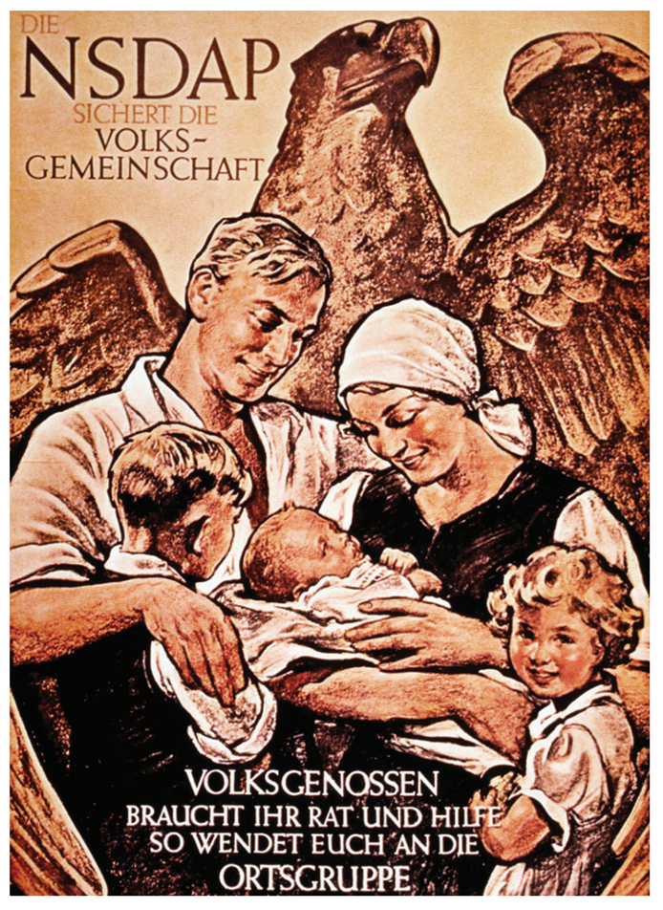
Strand Three: The History of Europe and the Wider World
Chapter Twenty-Four: Life in Nazi Germany
Diagram taken from Artefact, 2nd Edition by Eimear Jenkinson and Gregg O'Neill (educate.ie)
@MsDoorley

Slide 25
Checkpoint pg. 311 (Artefact, 2nd Edition)
  How did the Nazis try to reduce unemployment?
  How did industry expand under the Nazis?
  How did the Nazis use education to their advantage? Why did they target young people?
  What roles were women supposed to have in Nazi Germany? How was this promoted?
  How was a German woman meant to dress and style herself? Why?
Strand Three: The History of Europe and the Wider World
Chapter Twenty-Four: Life in Nazi Germany
@MsDoorley

Slide 26
Checkpoint pg. 311 (Artefact, 2nd Edition)
  The Nazis tried to reduce unemployment by providing work for people in public works schemes such as building motorways/Autobahnen or the OlympicStadium. They also banned trade unions and strikes.
  Industry expanded under the Nazis: the motor industry grew, with affordable cars being built such as the Volkswagen. Taxes were cut to promote private industry. Many companies such as Siemens and Krupps grew as a result. The manufacturing industry boomed with the renewed (and forbidden) production of ships, submarines, planes, weapons and ammunition.
  The Nazis used education to their advantage by concentrating on young people; youth groups were set up; textbooks were rewritten to glorify Hitler; teachers had to be members of the Nazi Party; there was a picture of the Führer in every classroom.
  The role of women in Nazi Germany was to stay at home to look after their family, and to have as many children as possible so the population would grow. This was promoted by the three Ks: Kinder, Küche, Kirche (Children, Kitchen, Church).
  Under the Nazis, a good German woman was meant to dress and style herself traditionally, wearing peasant costumes with flat shoes and wear her hair in plaits or buns. She was not to wear make-up, dye her hair, wear trousers or smoke in public.
Strand Three: The History of Europe and the Wider World
Chapter Twenty-Four: Life in Nazi Germany
@MsDoorley

Slide 27
Propaganda
Nazi propaganda was used to control which information reached the German public and to influence popular opinion.
  Joseph Gobbels was made Minister for National Enlightenment and Propaganda. He was in complete control of the press, radio, cinema, theatres and art. Books by Jews were banned, along with any books disagreeing with Nazism. Book burnings took place to rid the country of such books.
  Goebbels organised the production of cheap radios, called 'the people's radio', so that Hitler’s speeches could reach everyone. Loudspeakers were installed along streets.
  Posters were put all around Germany presenting Hitler as a Godlike figure, as we saw in Russia with Stalin. People had to celebrate Hitler's birthday, and 'Heil Hitler!' or 'Hail Hitler!' was a common greeting. The Nazi salute was made compulsory.
  The Nazis held party rallies in Nuremberg, Bavaria. The Nuremberg Rallies had a different theme each year. In 1934, the 'Rally of Unity of Strength' was held. It is best remembered because the documentary-marker Leni Riefenstahl recorded the event and made the propaganda film Triumph of the Will from it, promoting the cult of der Führer.
  The 1936 Olympics were held in Berlin. This was an opportunity to show off the great achievements of Nazi Germany and present it as a flourishing nation to the outside world.
Strand Three: The History of Europe and the Wider World
Chapter Twenty-Four: Life in Nazi Germany
@MsDoorley

Slide 28
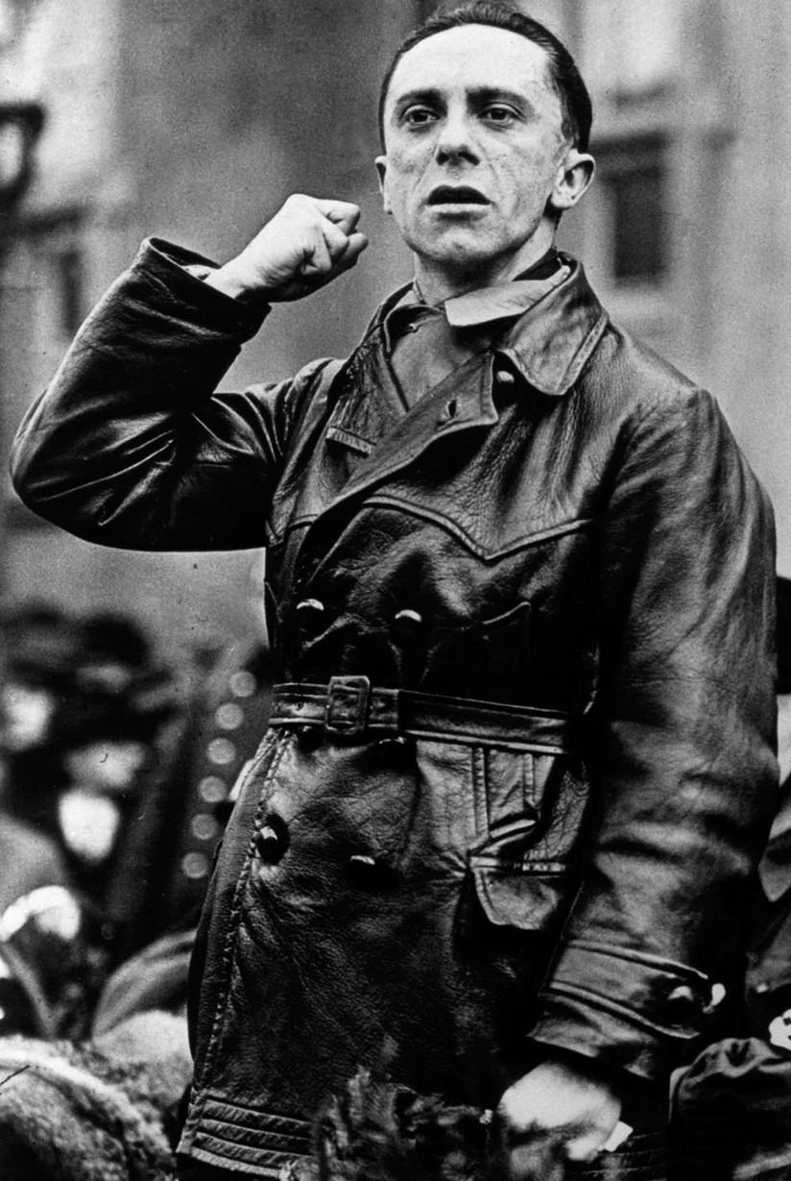
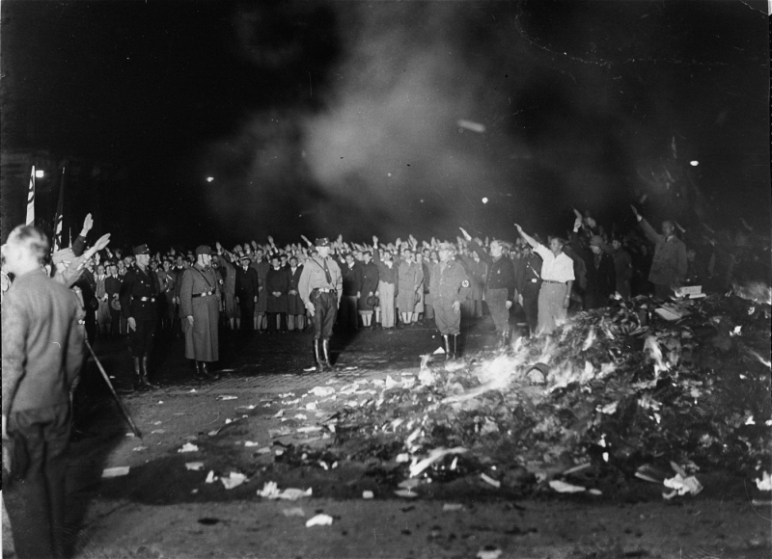
Did you know?
The first Nazi book burning took place on 10th May 1933 opposite Berlin's oldest university. Students carried thousands of books by authors with 'an un-German spirit' from the library to the fire. Today, there is a small, simple memorial and a plaque with a prophetic warning written by the German poet Heinrich Heine in 1820: 'That was just a prelude; where they burn books, they will eventually burn people too'. The Nazis would later kill 'undesirables' such as Jews, Roma Gypsies, LGBT+ and disabled peoples in the concentration camps before burning their bodies.
Strand Three: The History of Europe and the Wider World
Chapter Twenty-Four: Life in Nazi Germany
Diagram taken from Artefact, 2nd Edition by Eimear Jenkinson and Gregg O'Neill (educate.ie)
@MsDoorley

Slide 29
Terror
Hitler used terror to hold onto power and control his enemies.
  In 1933, the Gestapo (Secret Police) were set up by Hermann Göring and led by Heinrich Himmler. People were encouraged to report opponents or communists to the secret police.
  By 1934, Hitler believed his SA were a threat to him, particularly their leader Ernst Rohm. Hitler set up the SS as his personal bodyguards and they were also led by Himmler. On the 30th June, in a two-day purge known as the Night of the Long Knives, the SS killed the leaders of the SS and others they suspected of being a threat.
  From as early as 1933, critics of the regime or people who were considered undesirables in Nazi Germany were sent to forced labour camps, similar to Stalin's gulags. Among them were Jews, LGBTQ+ people, Roma people, people with disabilities, Catholic priests, Jehovah’s Witnesses, communists and journalists.
Strand Three: The History of Europe and the Wider World
Chapter Twenty-Four: Life in Nazi Germany
Did you know?
Hitler was nominated for the Nobel Peace Prize in 1939! However, the nomination was made by a Swedish democratic MP in the spirit of sarcasm and spoke of Hitler's 'glowing love for peace'.
@MsDoorley

Slide 30
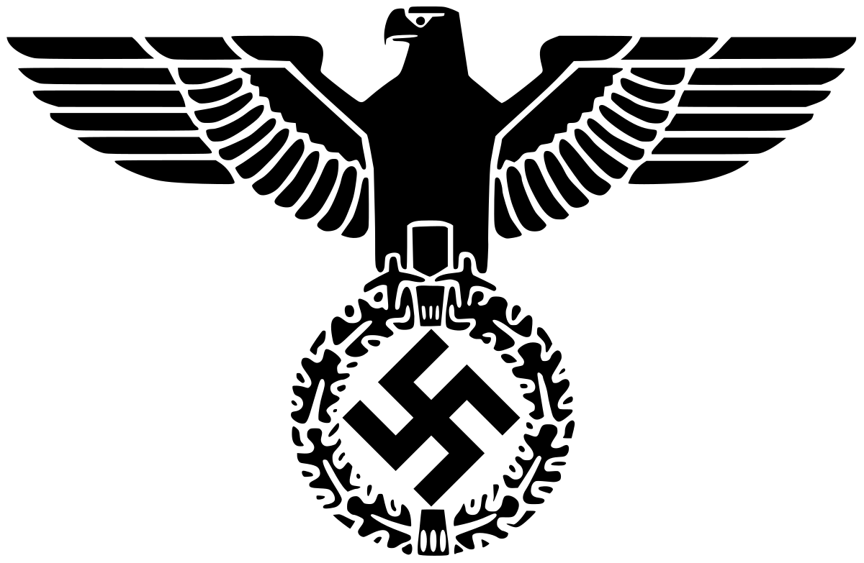
Strand Three: The History of Europe and the Wider World
Chapter Twenty-Four: Life in Nazi Germany
@MsDoorley

Slide 31
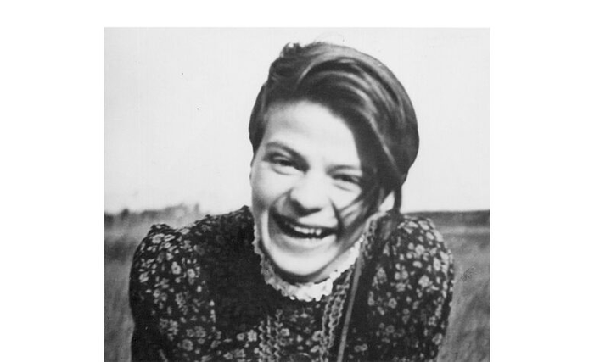
Sophie Scholl, 1921-1943
Sophie Scholl was born in Forchtenberg, Germany. At the age of 12, she chose to join the girl's wing of the Hitler Youth, the League of German Maidens. Her initial enthusiasm gradually became criticism. After graduating from school in 1940, she became a kindergarten teacher. In spring 1941, she began a six-month spell as a nursery teacher as part of the National Labour Service, which was used to militarise the workforce and indoctrinate it with Nazi ideology. The militaristic regimen there casued her to rethink her understanding of Nazism and to begin practising passive resistance. In 1942, her father served time in prison for making a critical remark to an employee about Hitler. The same year, Sophie enrolled at the University of Munic as a student of biology and philosophy. She made friends with a group of like-minded students through her brother Hans who was also studying there. Calling themselves the White Rose, Hands and his friends adopted a strategy of passive resistance towards the Nazis by writing and publishing leaflets that called for the downfall of National Socialism. When she discovered this, Sophie also joined the White Rose. The group had been horrified by reports of German war crimes on the Eastern Front. Sophie and the other members of the White Rose were arrested by the Gestapo on the 18th February 1943 for distributing their sixth leaflet at the University of Munich. Hans, Sophie and their friend Christoph were found guilty of treason and condemned to death. They were beheaded by guillotine on the 22nd February 1943.
Strand Three: The History of Europe and the Wider World
Chapter Twenty-Four: Life in Nazi Germany
Diagram taken from Artefact, 2nd Edition by Eimear Jenkinson and Gregg O'Neill (educate.ie)
@MsDoorley

Slide 32
Anti-Semitism
  For centuries, Jews have often been perceived as outsiders in European society. This sentiment can be traced back to events such as the First Crusades, which occurred between 1096 and 1099.
  By the time of Nazi Germany, this deeply entrenched prejudice was institutionalized through legislation such as the Nuremberg Laws in 1935. These laws stripped Jews of numerous rights, including the right to vote, own property, occupy certain professions, and marry non-Jewish citizens.
  The Nazi party, driven by a pernicious ideology, positioned Germans and other Nordic peoples as the 'master race' or Aryans, deeming Jews and other minority groups as inferior.
  In an effort to further isolate and stigmatize them, Jews were compelled to wear the Star of David, making them instantly recognizable, and were often relegated to living in confined ghettos.
  As Hitler's regime progressed, the treatment of Jews progressively worsened. This degradation reached a notorious peak during the "Night of the Broken Glass," or Kristallnacht, a violent episode in which Jewish properties were destroyed, 100 Jews were brutally killed, and countless others were sent to concentration camps.
  Notable figures, like physicist Albert Einstein, opted to flee the country in search of safety. Kristallnacht stands as a harrowing precursor to the atrocities that the Jewish community would endure throughout World War II.
Strand Three: The History of Europe and the Wider World
Chapter Twenty-Four: Life in Nazi Germany
@MsDoorley

Slide 33
Checkpoint pg. 313 (Artefact, 2nd Edition)
  What role did Joseph Goebbels play in Nazi propaganda?
  What were the Nuremberg Rallies?
  What was the Gestapo?
  How was terror used to ensure Nazi control of Germany? Give two examples.
  What was the Nuremberg Laws? How did they affect Jews living in Germany?
  What was Kristallnacht?
Strand Three: The History of Europe and the Wider World
Chapter Twenty-Four: Life in Nazi Germany
@MsDoorley

Slide 34
1920-1939
Chapter 24
24.4: SUMMARY
24.4: summary
Strand Three: The History of Europe and the Wider World
@MsDoorley

Slide 35
In this chapter, we have learned that...
  World War I and the Treaty of Versailles had a large impact on Germany.
  The National Socialist German Workers' Party (NSDAP), a fascist party, was founded in 1919. It was generally known as the Nazi Party. Hitler joined and soon became its leader.
  In November 1923, Hitler and the Nazi Party organised a rebellion in Munich, now commonly known as the Beer Hall Putsch. While in prison, he wrote a book called Mein Kampf, the Nazi manifesto.
  Several factors helped the Nazis to rise to power: the public's loss of faith in the Weimar government; the Great Depression; Hitler's leadership and policies; Nazi propaganda.
  In January 1933, President Hindenburg appointed Hitler Chancellor (Prime Minister) of Germany.
  Hitler used terror and propaganda to ensure that he kept control over Germany. The SS and the Gestapo enforced policies of terror. Examples of propaganda include posters, the Nuremberg Rallies, rewritten textbooks, youth groups and the Berlin Olympics.
  Hitler improved the economy of Germany by boosting private industry, introducing public work schemes and promoting the Volkswagen car.
  Hitler used education to influence German youth. Nazi youth groups included the Hitler Youth and the League of German Maidens. History books were rewritten and a portrait of Hitler was put in every classroom.
  Women were expected to stay at home and look after the family. Their life was to revolve around the three 'Ks': Kinder, Küche, Kirche (children, kitchen, church).
Strand Three: The History of Europe and the Wider World
Chapter Twenty-Four: Life in Nazi Germany
@MsDoorley

Slide 36
Reflecting on... Life in Nazi Germany
  Hitler's policies had a positive effect on the economy and for so many people, everyday life was improved. Poverty and unemployment were greatly reduced.
  However, Nazi propaganda and terror used to keep control of Germany impacted on people's lives in a negative way.
  Hitler used education to influence and shape the beliefs of young Germans.
  Women's lives were narrowed by Nazi policies, as they were expected to stay at home and raise large families.
  Jewish people suffered a slow process of dehumanisation that would be the precursor for what was to come under Hitler's plans for his Third Reich.
Strand Three: The History of Europe and the Wider World
Chapter Twenty-Four: Life in Nazi Germany
@MsDoorley

Slide 37
Examination Questions
Strand Three: The History of Europe and the Wider World
Chapter Twenty-Four: Life in Nazi Germany
@MsDoorley

Slide 38
Project
Guidelines:
  Length: The depth of your project should reflect about 2-3 weeks of work.
  Sources: Use at least three different sources for your research. These can be books, scholarly articles, or reputable online resources.
  Citations: All information and images that are not your own should be properly cited.
  Mediums: You may choose to present your project in one of the following ways:
    Poster: Your poster should be informative and visually engaging.
    Minecraft or Lego Model: If choosing this option, please also include a brief report explaining your model.
    Painting/Drawing: Your artwork should be accompanied by a description.
    Recycled Materials: Create your model using recycled materials and provide an explanation of your creative process.
Assessment:
Your projects will be assessed based on:
  Research and Content
  Creativity and Presentation
  Understanding of Context
  Adherence to Guidelines
Strand Three: The History of Europe and the Wider World
Chapter Twenty-Four: Life in Nazi Germany
@MsDoorley

Slide 39
Project
Historical Sites
Historical Figures
Reichstag Building, Berlin, Germany
Wannsee Villa, Berlin, Germany
Nuremberg Rally Grounds, Nuremberg, Germany
Dachau Concentration Camp, Dachau, Germany
Eagle's Nest, Berchtesgaden, Germany
Adolf Hitler
Hermann Goring
Heinrich Himmler
Joseph Goebbels
Martin Niemoller
Leni Riefenstahl
Gertrud Scholtz-Klink
Christine Bielenberg
Sophie Scholl
Strand Three: The History of Europe and the Wider World
Chapter Twenty-Four: Life in Nazi Germany
@MsDoorley

